Slide 1
Perinatal Loss: Improving Care Through Patient Feedback
Michele Kulhanek, MSN, RNC-OB, C-EFM

Slide 2
Objectives
Develop awareness of grief practices and phases of bereavement.
2. Identify patient/family wishes to help guide nursing interventions and to aid family in decision-making.
3. Provide information and resources to the patient/family through the use of compassionate, appropriate communication

Slide 3
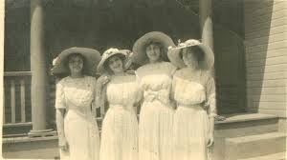
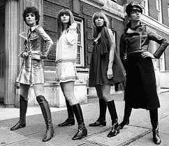
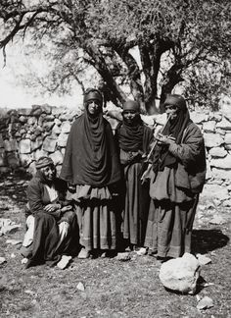
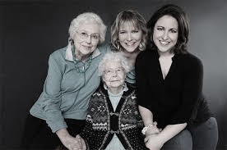

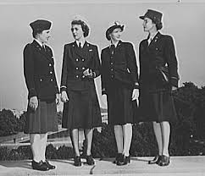
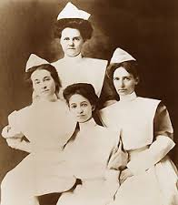
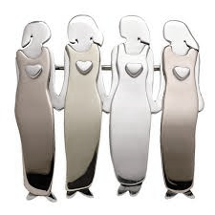


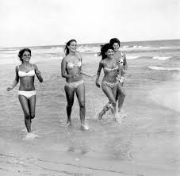
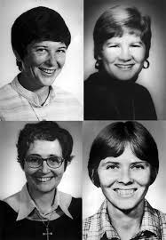
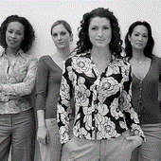
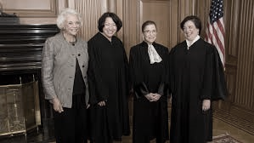
One in Four

Slide 4


Slide 5
Why are we not better about openly acknowledging our patient’s experiences of perinatal loss?
We assume they know the statistics
We don’t know what to say
We weren’t trained, lack of confidence or experience
It’s uncomfortable

Slide 6
grief ɡrēf/ noun: deep sorrow, especially that caused by someone's death.
Denial
Depression
Acceptance
Anger
Bargaining

Slide 7
bereavement
bəˈrēvmənt
noun
the period after a loss during which grief is experienced and mourning occurs
Shock and Numbness
Searching and Yearning
Disorientation
18th-24th month
5th-9th month
Reorganization
2nd week-4 months
First 2 weeks
Phases of Bereavement (Davidson, G.W., 1984)

Slide 8
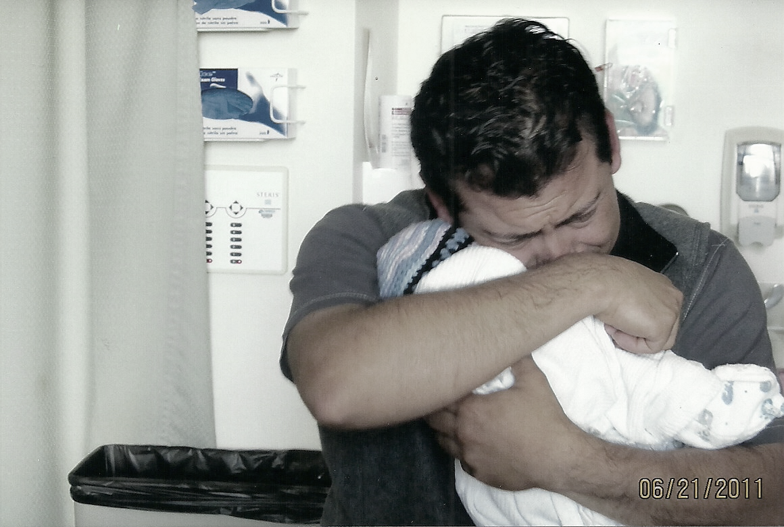
mourning môrniNG noun 1 : the act of feeling or expressing sorrow. 2 : an outward sign of grief for a person's death.
Photograph used with permission from the Agraz-Diaz family in memory of baby Briana

Slide 9


Experiences are Unique
Like a fingerprint, grief is a one-of-a-kind experience, unique to each person

Slide 10
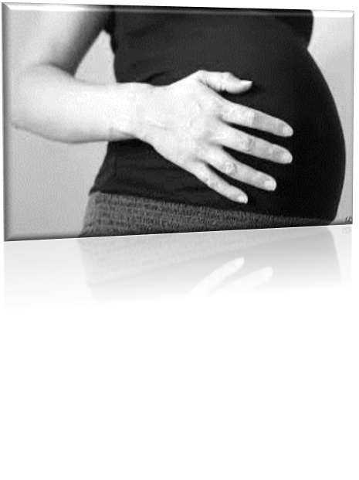
Journey of Care
We are now a part of their story
How do we change from nurse, midwife or doctor to grief counselor?
How can we possibly make their worst day the best it can be?

Slide 11
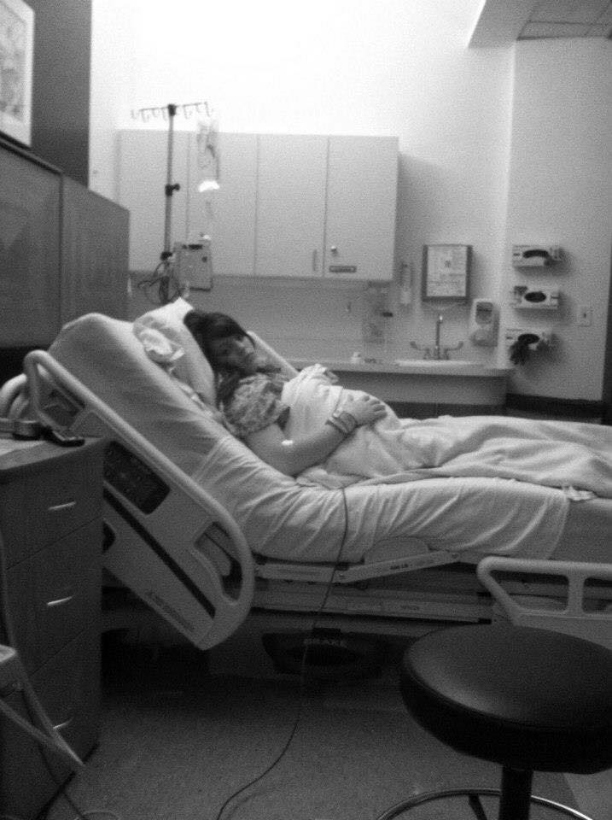
“I felt alone and afraid.”

Slide 12
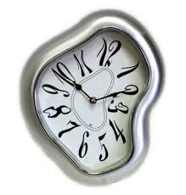
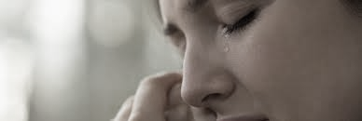
Shock and Numbness
Stunned, disbelief
Denial
Short attention span
Concentration is difficult
Decision-making impaired
Resistant to stimuli
Functioning impeded
Time confusion
Failure to accept reality

Slide 13
Sample Conversations
Why did this happen?
“We don’t always know why this happened to your baby. Many parents worry that they did something to cause it; for some this is the hardest part. We will try to find answers if we can. We can do tests on your baby that might give some answers. For some babies, we may never know why they died.”
Do I have to….?
“There are some things that can’t be changed, like when a baby has to be buried, or how you deliver your baby, but we’ll try to adapt things as much as we can. Remember to ask questions and tell us how you feel about things so we can provide the best experience possible. We promise we will let you know which things can’t be changed.”

Slide 14
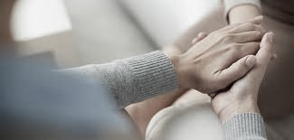
Use compassionate words they can understand
Bereavement Grief, sorrow, pain of your loss
IUFD, Fetal death Died before birth
Morgue, cooler Special waiting place
Pathology, autopsy Tests after death

Slide 15
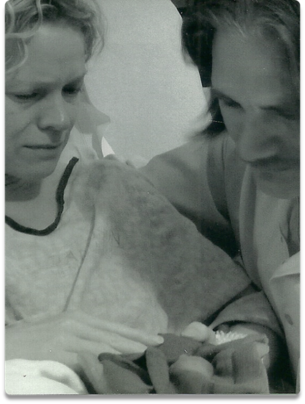
“You assumed my baby would die.” ~Amy
Photograph used with permission from the Erickson family in memory of baby Gabriel

Slide 16
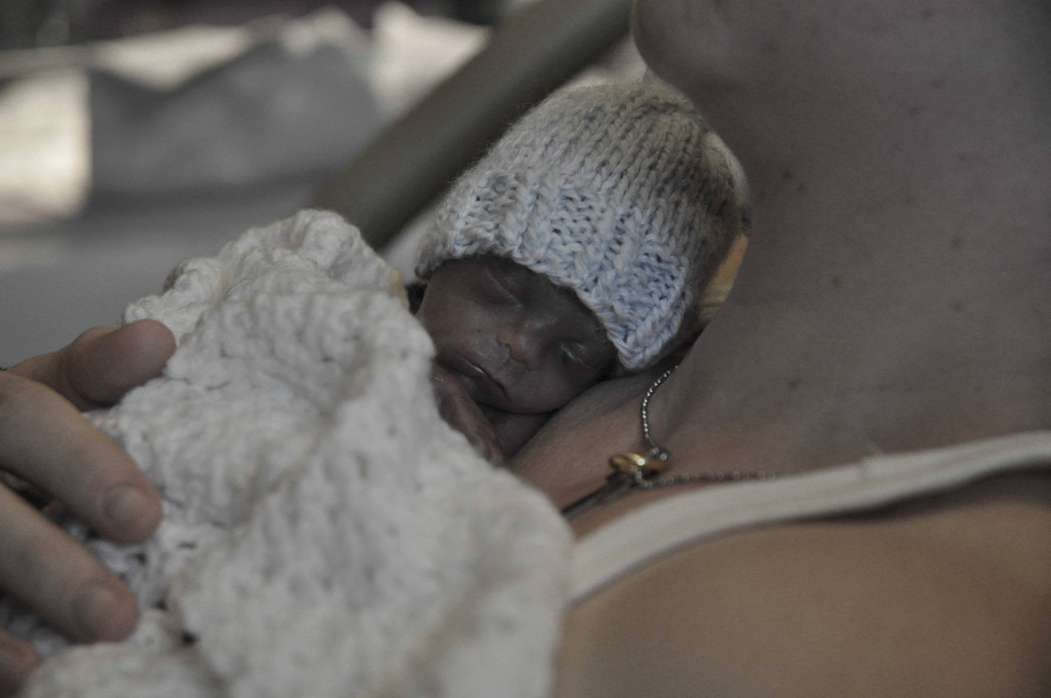
“Sometimes hope is all we have to sooth us.” ~Donna
Photograph used with permission from the Kerns family in memory of baby J

Slide 17
What did this pregnancy mean to you?
I wish things were different…
No words can express how sorry I am
I’m sure you are both exhausted. It must have been a long night.
Is there anyone I can call for you?
What is the one thing you are most fearful of?
Many families in your situation tell us…is it that way for you?
Other families who have been in this situation or in a similar situation…
RTS,2004
Notes:
.

Slide 18
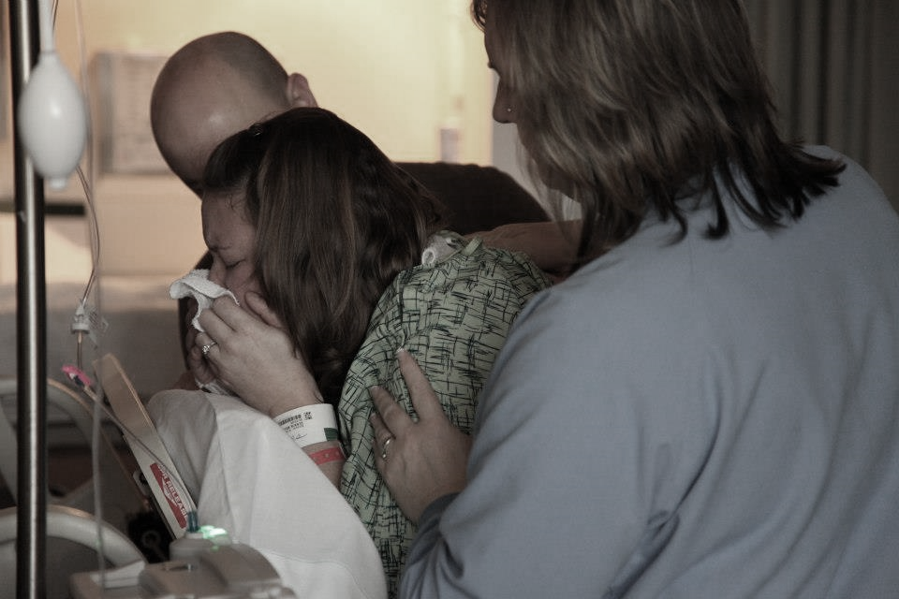
“Put all the cards on the table”
Photo used with permission from the Dennin family.
“I want to talk to you about your choices for _________. I know this is an overwhelming time and your brain probably feels a little foggy, so we’ll talk for awhile, then I’ll come back later and we’ll go over it again.”

Slide 19

“We didn’t know how to say goodbye. We didn’t even know what the options were. How were we supposed to leave the hospital without a baby?” Molly
“Our nurse was really knowledgeable about our options for burial at a funeral home. It was really the only decision we had to make before I went home.”
Stacey

Slide 20
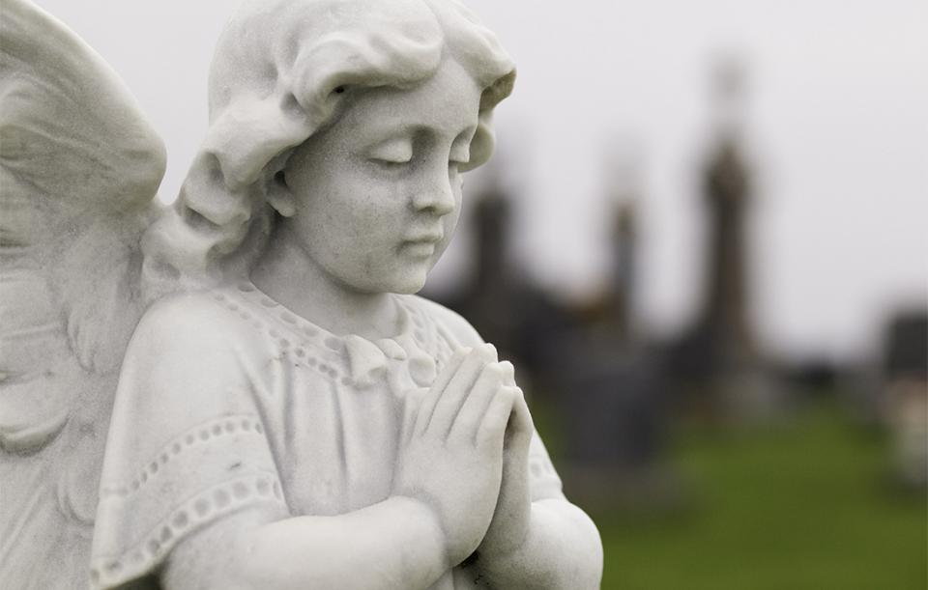
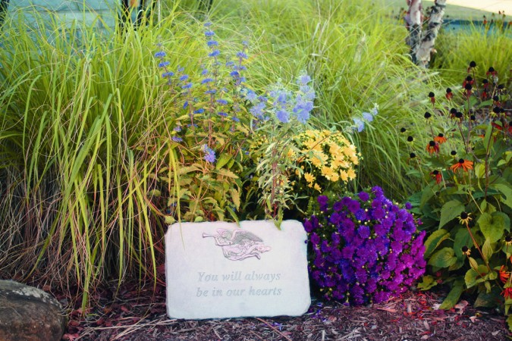
“How many more could I put there?”
Gabriel’s Garden…

Slide 21
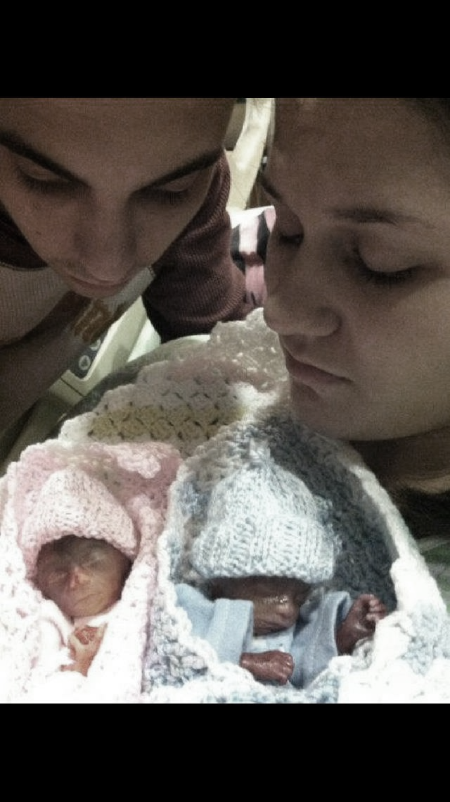
“Help me meet my babies.” ~Lena

Slide 22
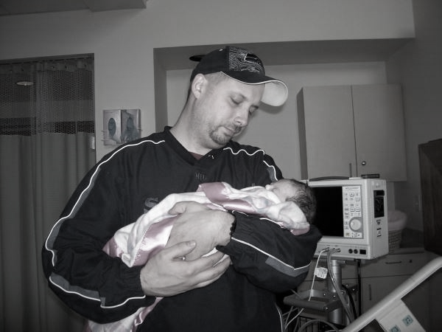
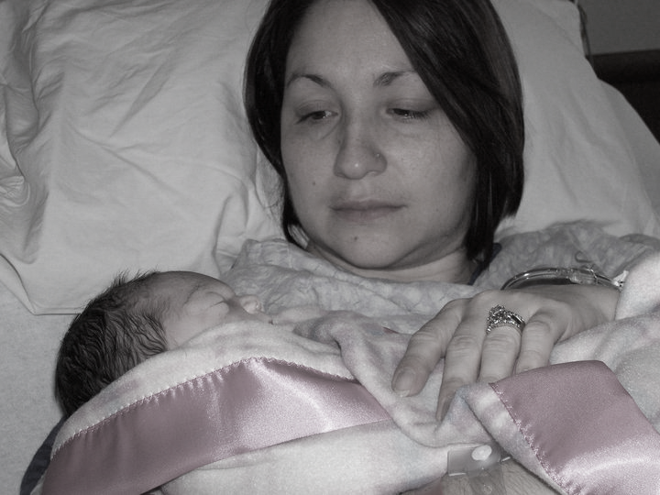
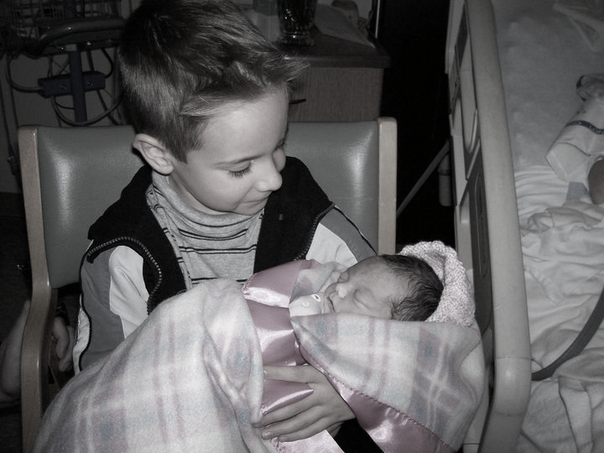
Photographs used with permission from the McGhee family in memory of baby Sophia

Slide 23
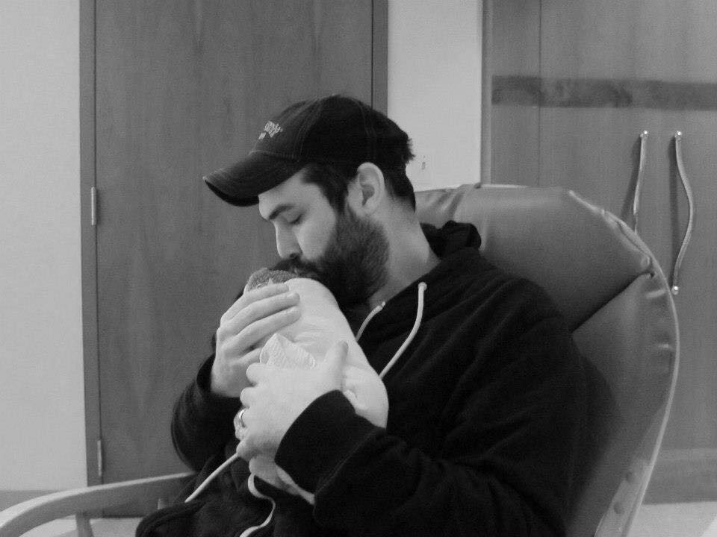
Photo used with permission from the Ormond Family.

Slide 24
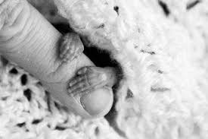
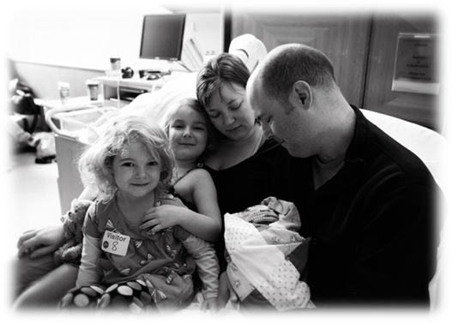
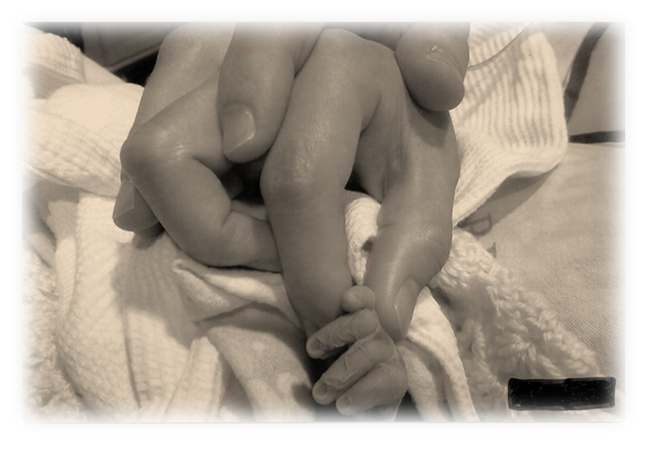
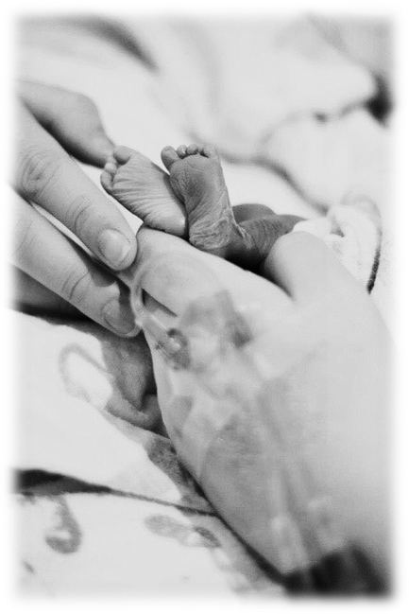
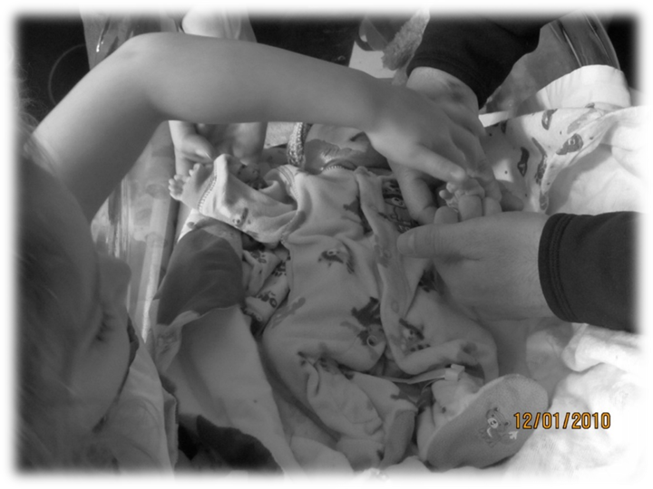
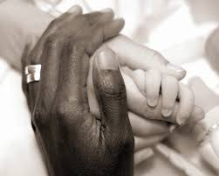
Include family members and focus on the perfect
Photographs used with permission from the Dennin family in memory of baby Conner

Slide 25
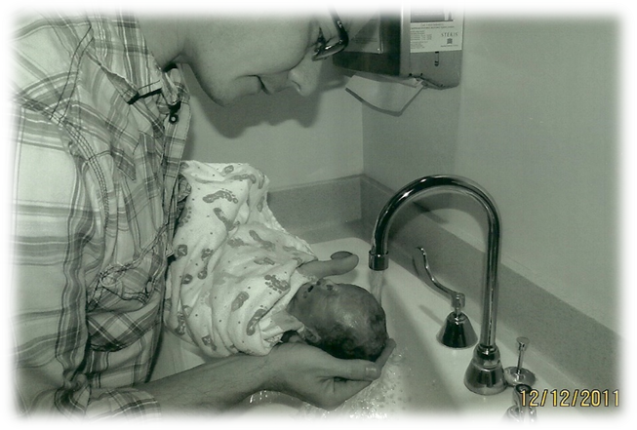
Respectful Care & Role Modeling Parenting

Slide 26

“The best thing was when they called her by her name, treated her with care and love ~ just like they would have for a live baby.”
Stacey
“All of my nurses did an amazing job at making me feel as important as all of the other moms there giving birth to live babies. I felt like Mya was treated as any other baby even though she was dead and not born alive.” ~Bethany

Slide 27
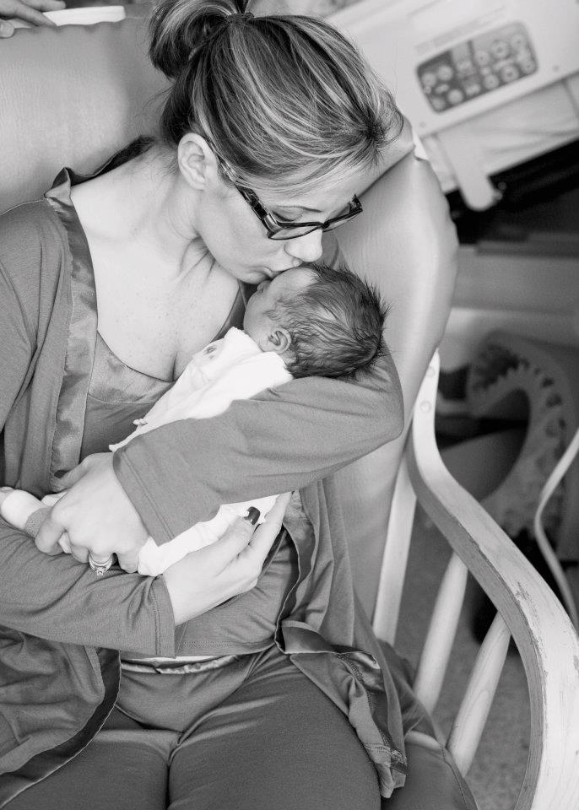
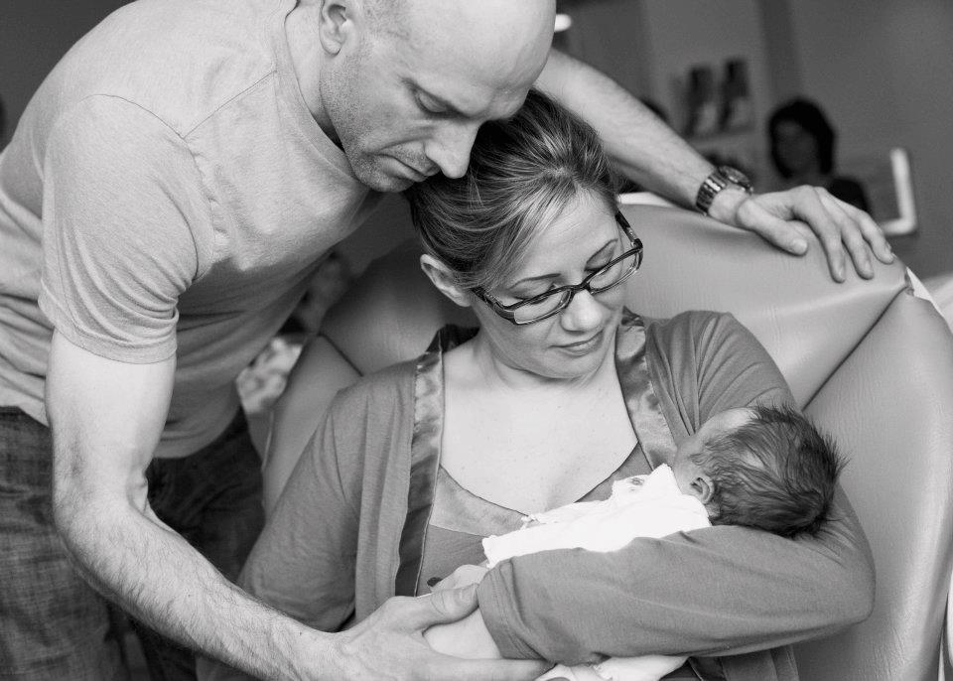
Photographs used with permission from the Wilson family in memory of baby Mia

Slide 28
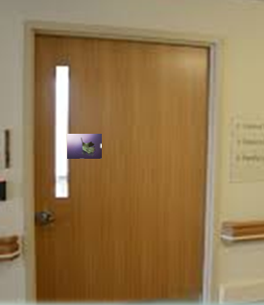

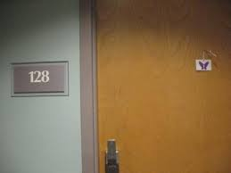
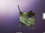
Difficult Lessons…

Slide 29
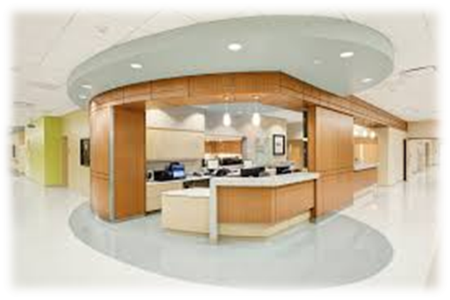
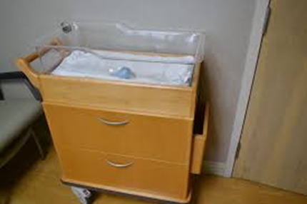
“How could they not have known? My grief was plastered across my face!”
“Maybe we’ll see you back in a year or two”
“Congratulations”

Slide 30
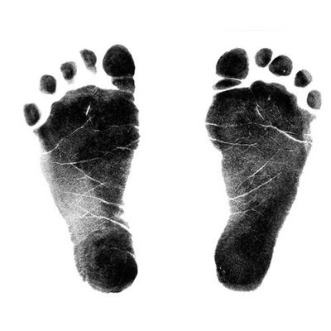
“The nurse took photos of me with Lily and James, she got photos of my entire family who stayed at the hospital too ~ we were all grieving. She kept our privacy and she was absolutely amazing with doing everything in her power to make my entire family and I as comfortable as we possibly could be considering the tragic circumstances.”
“I’m also very thankful for the person who took photos for us. It’s such an emotional and tiring time. Photos help to look back and remember.”
“There was a sweet nurse who shared the poem
‘Holland’ with us. I will never forget that.”
“I appreciated that the nurse didn’t force me to give my baby up until I was ready! That to me had the greatest impact! You guys allowed us to hold him for over a day. That may seem very morbid to many but that was the most healing part for me. I needed it!”
“She was an angel and just what we needed. She was always right there with genuine words of support and kindness. She cried with us, she laughed with us, she gave me resources I could utilize to help me with my grief and continuously reminded me that this wasn’t my fault and that I wasn’t alone!”
“Telling us about a local support group, and resources that help with expenses, that was invaluable information to give a family as they prepare to go home.”
“I remember a sweet nurse who was involved right from the beginning the night I went in for delivery. She was so empathetic and kind.”
“I could tell the feeling for us was genuine and that helped us feel not so alone.”

Slide 31
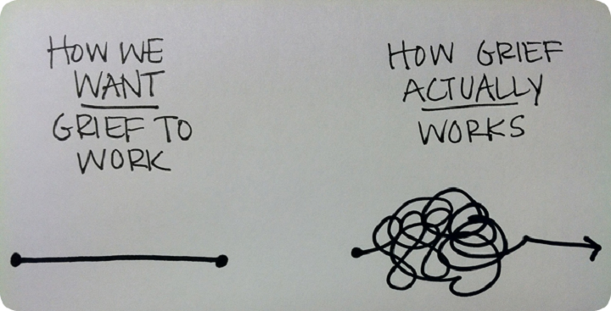
Pain is a part of the journey
It isn’t mine to fix
Let go of the old stuff; start new with each family
It is an awesome responsibility when our care impacts the quality of parent’s healing
Thank the patient and family. It really is an honor and a privilege to care for them.

Slide 32
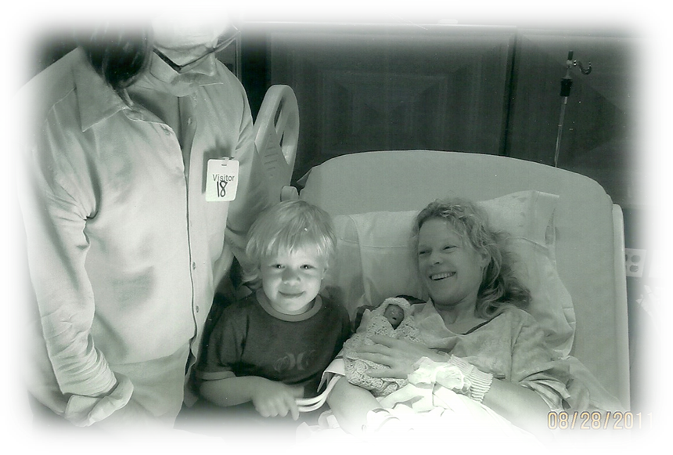
Every baby has a legacy…
Photograph used with permission from the Erickson family in memory of baby Gabriel

Slide 33
Kulhanek@uw.edu
mkulhanek11@gmail.com
Cellular: 360-434-3436

